Slide 1
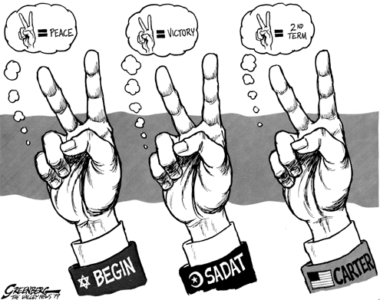
Camp David and Peace Accords
Alexandra Malgarini
Diana Coronel
Jose Franco

Slide 2
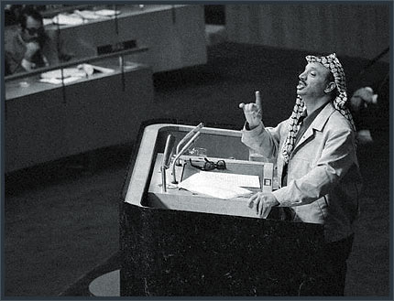
Arafat at the UN
At the end of 1974 Arafat was invited to speak at the UN for the first time.
His claim was that the real cause of the Palestinian conflict is the cause of the people deprived of its homeland, dispersed and uprooted and leaving mostly in exile and refugee camps.
The world leaders realized that if the Palestinians could be granted a homeland then permanent peace in the Middle East was possible.

Slide 3
Opposition to Arafat
The Israelis were furious with the United Nations for inviting Arafat to speak.
They claim the PLO was a murder organization.
Refuse idea of a separate Palestinian state.
They feared Palestinians aimed to take back all of Israel and not be content with a close state next door to Israel.
PLO divided. Some extremists thought that Israel should be destroyed and taken over by Palestinians.
1970 they launched terrorist attacks both inside Israel and in other parts of the world.

Slide 4
Lauching Peace
With the help of American mediation, a peace treaty was signed in 1979
November 1976 – election of Jimmy Carter as president of the US
Thought a Middle East settlement could be based on Security Council Resolution 242
Withdrawal of Israel armed forces from territories occupied in the recent conflict (Six Day War)
Termination of all claims or states of belligerency and respect for and acknowledgment of the sovereignty, territorial integrity and political independence of every State in the area and their right to live in peace within secure and recognized boundaries free from threats or acts of force."
May 17, 1977 Menachem Begin came to power.
West bank and Gaza strip “ were as Jewish as Tel Aviv”
The October war had severally depleted Egypt’s economy.

Slide 5
Sadat flies to Israel in 1977
The bravest peace-maker was president Sadat of Egypt, he wanted peace to recover from the war.
For 30 years Egypt had refused even to accept Israel existence.
In 1977 he surprised the world by announcing that he was willing to go to Israel and discuss peace.
Sadat outline the principles for a peace agreement:
Withdraw of Israel from the Arabs territory
Palestinian self determination
Begin was uncompromised: Jerusalem would never again be divided.
Agreement: Israeli withdrawal from all Sinai and effective demilitarization of the peninsula.
Sadat failed to mobilize any Arab support.
Arab States declared an economic and diplomatic boycott of Egypt.
Sadat responded by breaking off relations.

Slide 6
Egypt received sovereignty over all of Sinai.
Israel would not impose its sovereignty over the west bank and Gaza but would not withdraw.
The following months the Israeli Prime Minister Menachem Begin went to Egypt and peace talks started.
Begin wanted limited “self-rule” for Palestinians and would only withdraw from Sinai if Israeli troop and air bases remained along Sinai’s eastern shore.
Sadat wanted complete Israeli withdrawal
In January 4, 1978, Carter met Sadat in Aswan (Egypt) and made the “Aswan Declaration” which asked for:
Withdrawal by Israel from territories occupied in 1967 and agreement on secure and recognized borders
A resolution of the Palestinian problem in all its aspects.
However, due to Palestinian terrorism attacks in Egypt the Egyptian – PLO relations went into a deep freeze and in March of that year the IDF invaded south Lebanon destroying PLO bases.
In 1978, Sadat and Begin were invited to Camp David in rural Maryland. Where the relative privacy and seclusion might provide a setting for a breakthrough.

Slide 7
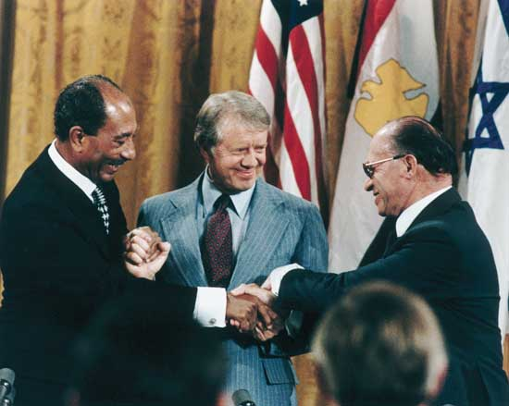
The Camp David accords
Camp David agreements began on September 5th, 1978 and lasted for 13 days.
While Carter’s relation with Sadat was excellent, with Begin, his relation was far more tense.
Egypt would drop its demand that Israel commit itself explicitly and in advance to eventual withdrawal from the Palestinian territories in exchange for Israeli agreement to give up the northern Sinai settlements and air bases along the Sinai itself.
It was agreed that :
Israeli forces to be withdrawn from Sinai.
Egypt to regain all of Sinai within three years.
Israeli shipping to have free passage through the Suez Canal and the straits of Tiran.
The Egyptian economic boycott was to be lifted and economic relations to be established.

Slide 8
On September 17th 1978, Carter, Begin and Sadat signed two documents:
“Framework”:
Israel would completely evacuate Sinai in exchange for diplomatic recognition by Egypt
Israeli shipping was to enjoy unimpeded passage through the Suez Canal, the Gulf of Suez, the Straits of Tiran and the Golf of Aqaba
“Framework for Peace”:
UN Resolution 242 must serve as the basis for a peaceful settlement of the conflict.
For the Palestinian problem: Transfer of power in the West Bank and Gaza and negotiations for it self-governing authority.

Slide 9
Post Camp David
USSR was against the agreements on the contrary of Israelis who favored them.
During the Arab Summit Meeting, in November 1978, it was decided on sanctions that would automatically be imposed on Egypt in order to conclude a bilateral peace treaty (Camp David Accords) meaning:
Egypt would be expelled from the Arab League
The League’s headquarters would be removed from Cairo
Egyptian bodies maintaining relations with Israel would be boycotted

Slide 10
The Israeli –Egypt Peace Treaty, 1979
Six months after Camp David in March 1979 the Egyptians and the Israeli leaders signed a peace treaty which confirmed what they had agreed at Camp David.
Both sides agreed to recognize each other’s right to live in peace within their secure and recognized boundaries.
The main problem remained the West Bank and Gaza
Israel still sought American commitment on financing the withdrawal and an Egyptian commitment on the supply of oil, to make up for the oil lost by its withdrawal of the Sinai fields, for which Egypt was reluctant.
Israel was America’s only reliable ally in the Middle East and Stand stood in the path of a Soviet takeover of Saudi Arabia

Slide 11
US made Egypt guarantee Israel a substantial supply of Sinai oil and Sadat agreed to do so.
Sadat had won back all of Sinai (withdrawal of Israel) and freed Egypt from the economic and military burden entailed by its conflict in Israel.
Begin, who was probably the most satisfied with the agreements, has successfully warded off all efforts for having forced decisions and promises to be made regarding the Palestinian problem and had avoided the withdrawal from the West Bank and Gaza
The Arab states had removed Egypt form the League and the country’s oil export + grants and loans were suspended.
The signing of the Egypt-Israel peace treaty was a great breakthrough in Arab-Israeli relations and its agreements implemented. However, the Palestinian problem still remained at the heart of the conflict in the Middle East.

Slide 12
Timeline
1974 – Yasser spoke at the UN
1976 –November- election of Jimmy Carter as president
1977
May 17 - Menachem Begin came to power
November 19 - Sadat landed in Israel
1978
September 5- Sadat and Begin went to Camp David
September 17- Carter, Begin and Sadat signed two documents.
1979
March 26- Israel and Egypt signed the peace treaty.
May 25 IDF withdrew from successive chunks of western and central Sinai.
1980
January 25- Completed the interim (first stage) withdrawal to Al-Arish-Ras Muhammad line.
February- Israel and Egypt exchanged ambassadors.

